Slide 1


Microsoft Malware Prediction
Rohit BHALERAO, Tim HOLLINGER, Swetha KALLAM

Slide 2
Table of Contents
01
Data Pre-processing
02
Modelling
03
Experimental Setup
04
Results
Cleaning the data and dealing with categorical variables, missing values
Training ML models and comparing their performances.
Feature selection and hyper-parameter tuning.
Benchmarking the model performances.

Slide 3



The problem statement
Malware
Microsoft-Kaggle
Kaggle 2018
Dangerous to consumers and companies that rely on technology,
Microsoft , with a billion active users, takes cyber security seriously
In a measure to protect the Microsoft community from malware attacks, Microsoft launched two Kaggle challenges in 2015 and 2018.
Uses a sampled dataset of Microsoft machines that have or have not been attacked by Malware.
Using the properties of these machines, data scientists predict if a new machine with a given set of properties is prone to malware attacks or not.

Slide 4
01
Data pre-processing

Slide 5
8,921,483
The Data
Training data
7,853,253
Test data

Slide 6
Our Approach
Subset
Train-Test
Result
Took a 10% random sample from the total training data
No special sampling needed as data already had a uniform distribution w.r.t to the target/label
Out of the sample, we used 60% of it as training data and the remaining as test data
535,124 – train
356,749 - test

Slide 7
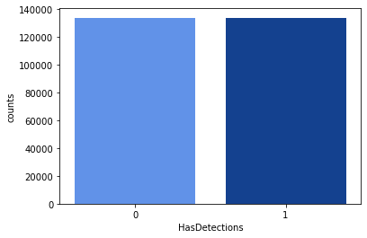
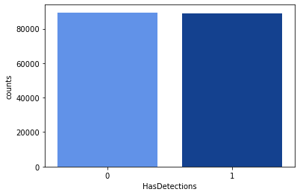
Distribution of label/target
Train
Test

Slide 8
Data processing
Column types
Missing values
Character
Character – 30
Numeric - 53
3 columns with nulls in more than 90% of data volume, dropped
11 columns with more than 20 categories – dropped
Categorical
One-hot encoding
Numeric
Missing values : Created new category “Missing”
Imputed with mode
Categories with very few counts combined and renamed as “Others”
Dummy variables for all the categorical variables
Any new categories in the test set were dropped
Most numeric columns are in-fact categorical, dummy variables with 0/1
Imputed missing values with mode

Slide 9
02
Modelling

Slide 10
Model Selection
Model Comparison
Model Evaluation
Best Performer
Decision Tree
Logistic Regression
Solver: LBFGS
Max iterations: 500
Random Forest
Estimators: 100
Boosted Tree
Gradient Boosting
Comparison of AUC and Accuracy
Re-evaluation between Gradient Boosting and Boosted Tree
Gradient Boosting evaluated with 400 estimators
Boosted Trees
AUC: 0.686
Accuracy: 0.628

Slide 11
03
Experimental Setup

Slide 12
Methodology
Model and Feature selection
Hyper-parameter tuning
Metric evaluation
Cross-validation

Slide 13
Our Approach
Feature Selection
Trying different thresholds for AUC
Select 118 features
Hyper-parameter Tuning
Perform grid search for best parameters
K-Fold cross validation for 5 and 10 folds
Choosing a 5-fold cross validation :
Less CPU computation, less variance, more bias.
Cross-validation
Metric Evaluation
Selecting model based on AUC
Metric Evaluation on AUC, Precision, Recall and F1 score.

Slide 14
04
Results

Slide 15
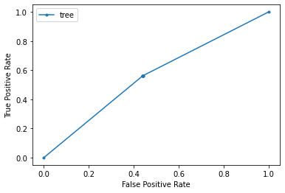
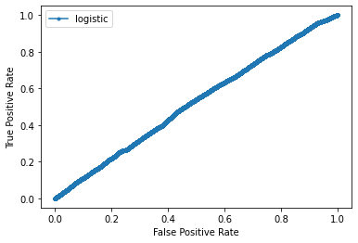
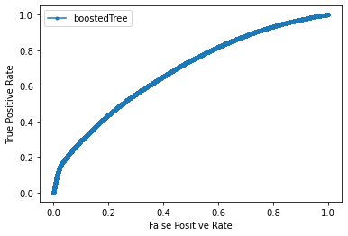
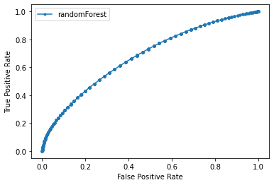
Evaluating models before experimental setup
Decision Tree
AUC : 0.56
Accuracy : 0.56
Logistic Regression
AUC : 0.52
Accuracy : 0.50
Boosted Tree
AUC : 0.68
Accuracy : 0.62
Random Forest
AUC : 0.67
Accuracy : 0.62

Slide 16
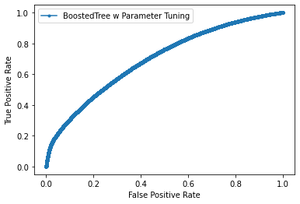
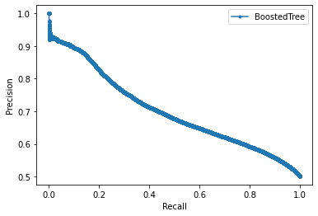
Model Performance after experimental setup
Boosted Tree
AUC : 0.71
Accuracy : 0.64
Precision : 0.64
Recall : 0.629
F-Measure : 0.634
Model Parameters:
colsample_bytree = 0.66, learning_rate = 0.2, max_depth = 5, num_leaves = 16, objective = 'binary', random_state = 1,
reg_alpha = 1.2, reg_lambda = 1, subsample = 0.7

Slide 17
Thank you
Questions?

